Slide 1
California Prunes Digital & Social Promotions 2020

Slide 2
Wellness Hub Promotion – PBH Connection June 2020
Have A Plant newsletter (6/2)
34,390 deliveries
5,407 impressions
75 clicks

Slide 3
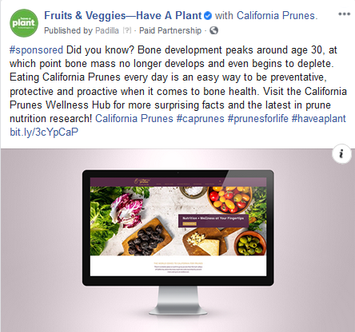
Wellness Hub June 2020
Facebook
Total Impressions: 58,318
Total Reach: 57,084
Total Engagements: 11 (likes, comments, shares)
Twitter
Total Impressions: 15,687
Total Engagements: 1

Slide 4
Key Learnings
The bone health promotion performed well on Twitter and is in line with anticipated metrics for paid promotions on FB. Strategic targeting to 62M health professionals and those interested in dietetics, human nutrition and nursing/medicine via the FB audience tool is a valuable way to reach this specific audience, and other topics of interest for future promotions should be considered.
Considerations for future content:
Short videos and animated content (e.g., boomerangs, GIFs) perform very well on our social channels and resonate with our audience. Consider leveraging this type of content in future promotions.
Tips/tricks and information on food waste reduction, food storage and food safety during the COVID-19 pandemic have been topics of interest among our social media audiences. Consider continuing to provide content related to these topics.
Compelling recipe content resonates well with our audience. In addition to finger foods/appetizers/snacks, recipes that feature quick breakfast ideas, smoothies and easy side dishes perform well across PBH social media platforms.

Slide 5
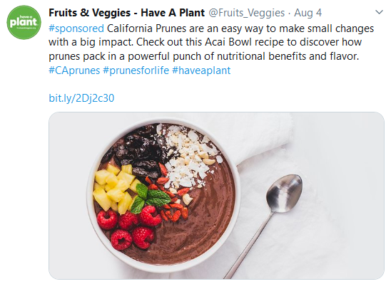
Acai Bowl August 4, 2020
Facebook
Reach: 69,949
Impressions: 72,839
Engagements: 23 (likes, comments, shares)
Twitter
Impressions: 21,542
Engagements: 6

Slide 6
Key Learnings
The Acai Bowl recipe Twitter promotion was among our top 10 highest-performing paid member Twitter posts in from June 1st through August 13th based on both impressions and engagement.
The Acai Bowl Facebook promotion performed within the anticipated range for this type of promotion, receiving 72,839 impressions and 23 engagements.
Considerations for future content:
As opposed to static images, consider providing interactive content: short videos, boomerangs and animated content related to prune recipes, tips for fun ways to use prunes, #DYK facts as well as additional seasonal recipes that prunes can be utilized in.
Tips/tricks and information on food waste reduction, food storage and food safety during the COVID-19 pandemic continue to be topics of interest among our social media audiences. Consider providing content related to these topics.

