Slide 1
The Role of Market Research in Selling More Prunes
Brad Rose, Rose Research

Slide 2
METHODOLOGY
Today, we will be looking at insights from 3 different markets, with different objectives and different research approaches:
Italy: a mature market, where consumer tracking has been conducted for many years
Japan: a mature market, with new advertising testing and tracking
UAE: a potential new export market for the CPB
Large scale consumer (and trade) interviewing has been conducted in a number of key markets – analyzing attitudes and usage with respect to prunes, as well as tracking advertising/ promotional awareness and impact.

Slide 3
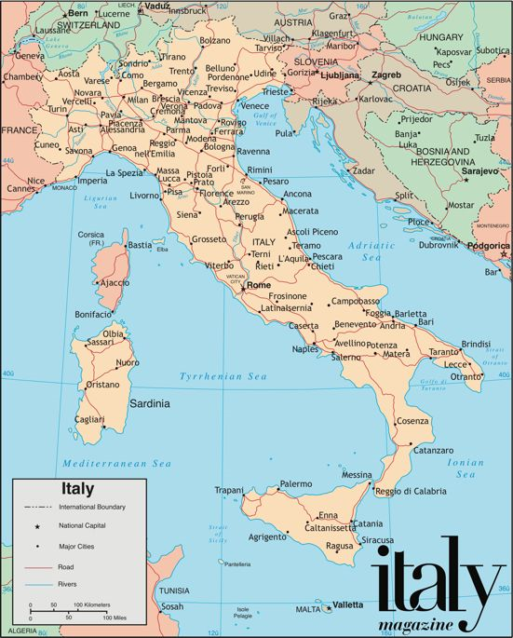
ITALY – A MATURE MARKET
The Situation: Italy is an attractive export market for the CPB – from both a scale and profitability standpoint
Action: Consumer tracking research, and
Promotional activity to encourage consumers to add prunes to their diet
Results: Consumer research illustrated improvements on a number of key metrics
Exports are up!

Slide 4
ITALY – OVERVIEW
A large, profitable market, despite Chile undercutting our premium price
Price/MT:
42% higher than the average for US Exports
Source: FAS to Year End 2019

Slide 5
FACTORS THAT INFLUENCE PRUNE PURCHASING
What factors influence Italian consumers when they’re buying prunes…
Q. What is important to you when choosing to buy prunes? Please rate the following factors according to their importance to you.
Notes:
A setup to understand what consumers say they’re looking for – price is important, but not the whole picture

Slide 6
PRUNE PURCHASE INTENT
Purchase intent has remained strong among Italian consumers (our normative target is 70 – 75% for an established commodity)
Q. If you were food shopping today and prunes were available at an acceptable price, how likely would you be to buy them? Would you say you..

Slide 7
ADVERTISING RECALL
Is the advertising/promotional campaign generating consumer awareness?
Q. Irrespective of where or when you saw or heard about them, are you aware of any advertising, promotions or have read articles in the press or in leaflets for prunes in the last 12 months?

Slide 8
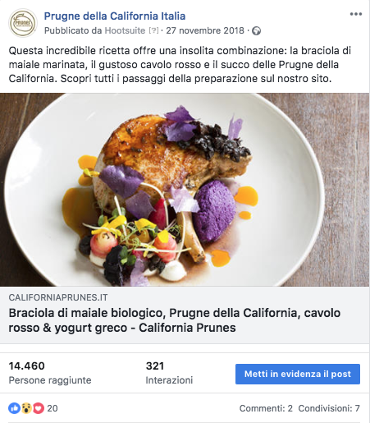
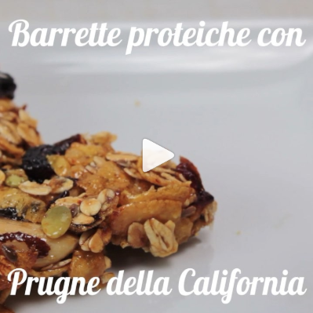
ACTION WE TOOK – AN OVERVIEW
Notes:
Wellness exhibition to promote health benefits, Sampling for taste
Online (FB, Insta) including high-profile influencers

Slide 9
SPECIFIC MESSAGE RECALL
Is the messaging taking hold?
Q. Which of the following messages about California prunes do you remember seeing or hearing?
Notes:
While overall recall of the ad was almost the same, look at the differences in terms of message recall – the advertising is having an impact!

Slide 10
IMPACT OF THE ACTIVITY
How will these activities impact purchasing moving forward?
Q. Based on what you have seen or heard in the past 12 months, will you buy prunes…?

Slide 11
IMPACT OF THE ACTIVITY
+3%
+4%
Source: FAS Export data. Year to Date (August-December 2019) vs same period in Prior Year.

Slide 12
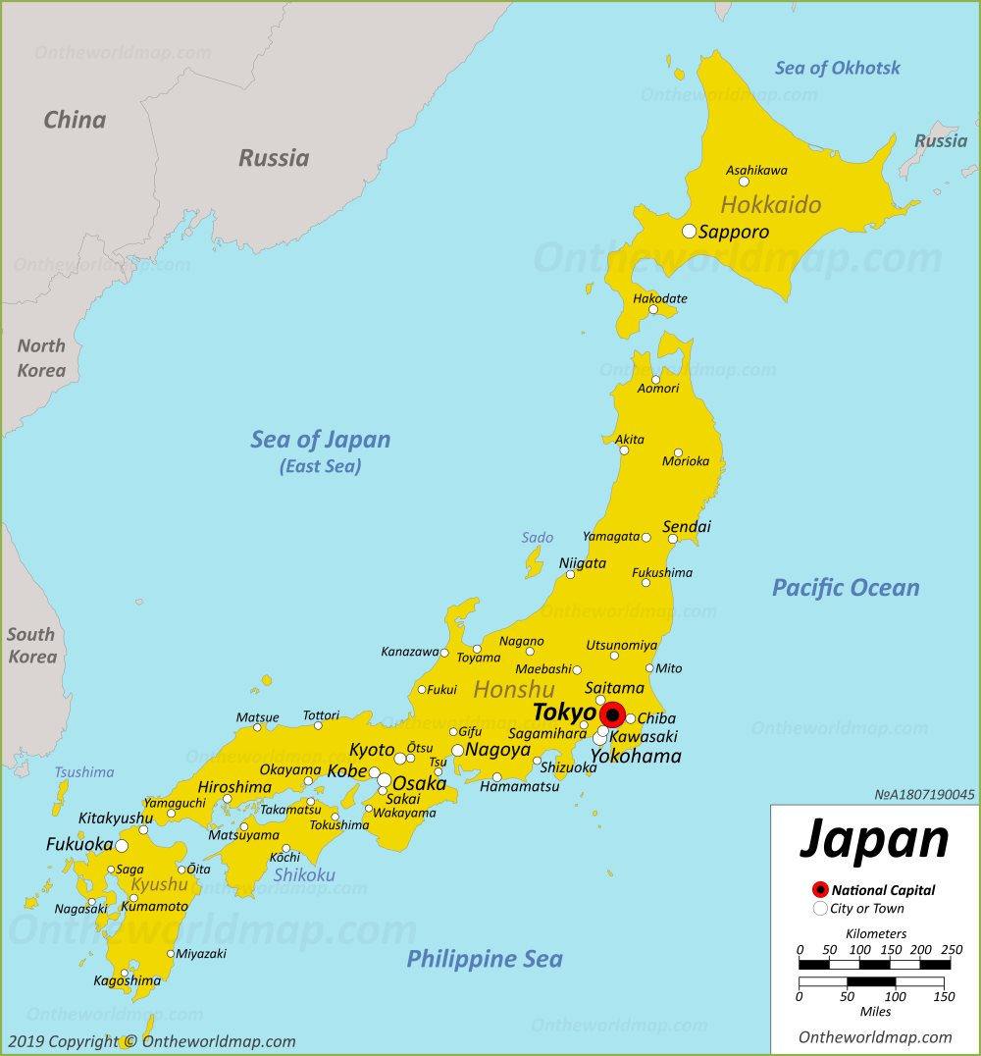
JAPAN – IMPLEMENTATION OF A NEW CAMPAIGN
The Situation: An attractive market (both large and profitable for the CPB)
The Issue: Prunes are expensive
Action: The CPB won an ATP investment in the market, for Autumn advertising campaign
Consumer research: A&U study + Ad development – led to a new TV campaign
Results: Consumer research identified positive ad tracking results.
In-store sales are up!

Slide 13
JAPAN – OVERVIEW
Largest US export market: 20% of US Prunes export value
Issue: Japanese consumers find California Prunes expensive
Price/MT:
19% higher than the average for US Exports
Top 3 Reasons for Not Buying California Prunes:
Expensive
Dislike the taste
Don’t look appetizing
Source: FAS to Year End 2019

Slide 14
WE TESTED FOUR CREATIVE ROUTES
The 4 storyboards were tested in the qualitative phase, against key metrics…
Notes:
Even though the data is qualitative, we saw a consistent story in each of the 4 groups we conducted!

Slide 15
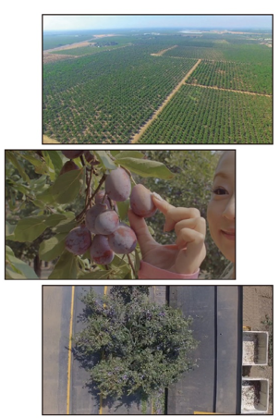
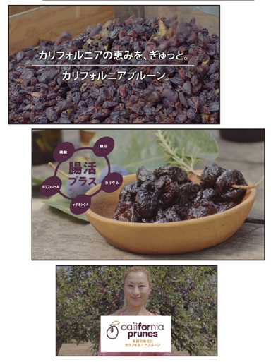
THE BLESSINGS OF CALIFORNIA
As noted in the previous slide, “The Blessings of California” concept elicited the most favorable results on virtually every key measure among women in Japan (both younger and older).

Slide 16
ACTUAL VERBATIMS FROM THE CONSUMER RESEARCH
“Seeing this ad and these images makes me think that California prunes are good quality – it shows the quality of the prunes that are produced there.”
“You can see how prunes are harvested and can see the process. This was very clear and easy to understand. The theme to me seems to be the quality of California grown prunes. You know that they’re made naturally and you can see the farmland. I really liked where it said – the world comes to California for prunes. They’re recognized around the world about being high quality.”
“The only element of this ad that I would suggest changing would be the woman. She seems a bit out of place in this ad. I think that I’d like to see someone who works on the prune farm in the ad – a California prune grower – since this is what we’re advertising.”
Notes:
Look at the bottom verbatim – it generated a lot of consensus among the women – so we were able to change the ad and include a California farmer!

Slide 17
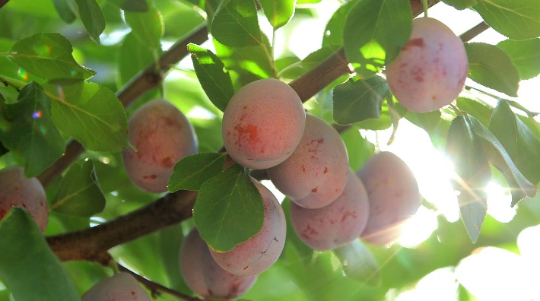
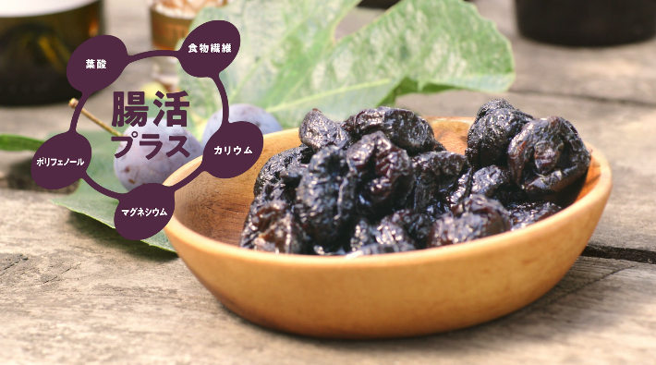
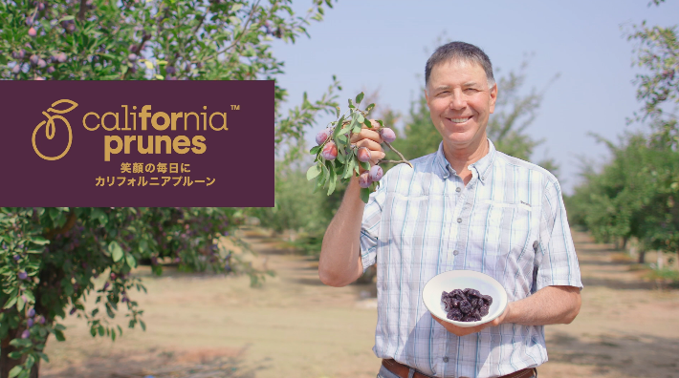
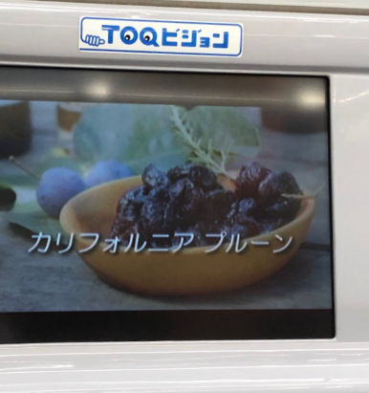
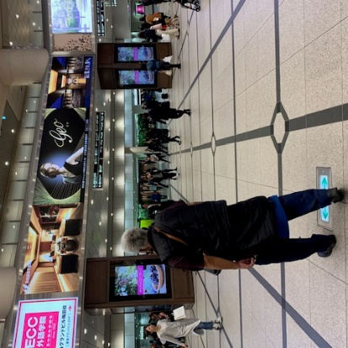
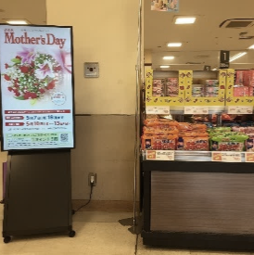
THE FINISHED ADVERTISING
Train Carriages & Stations
Digital Instore
& POS support
First TV Campaign in 6 years
Digital Media Advertising

Slide 18
JAPAN – TRACKING THE CAMPAIGN
In November, 2019 (at the conclusion of the TV flight), a quantitative study was conducted among 2,000 consumers in Tokyo and the surrounding areas – where the commercial was run.

Slide 19
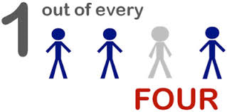
HOW DID THE AD PERFORM IN THE “REAL WORLD”?
For a new campaign, the ad elicited strong recall and motivation scores
25% of the respondents recalled seeing the prune advertisement – a strong score for a new campaign!
Q. Please watch the following video – do you remember seeing this ad? Q. And, does the main idea or message of the ads make you want buy CA prunes?
Notes:
Strong recall for a new campaign – and top-2 box purchase intent is strong

Slide 20
POSITIVE IMPACT ON PURCHASE INTENT
What impact will the advertising have on future behavior – over half said that they’ll buy prunes more often!
Q. Based on what you have seen or heard about prunes, will you buy prunes…?

Slide 21
IMPACT OF THE ACTIVITY
Sales increased in those regions where advertising took place.
-5%
+6%
Before advertising
Source: Store Sales POS data. Before advertising in selected regions (2 weeks to Oct 14 2019) and during (2 weeks to Nov 11 2019) vs same periods Prior Year.

Slide 22
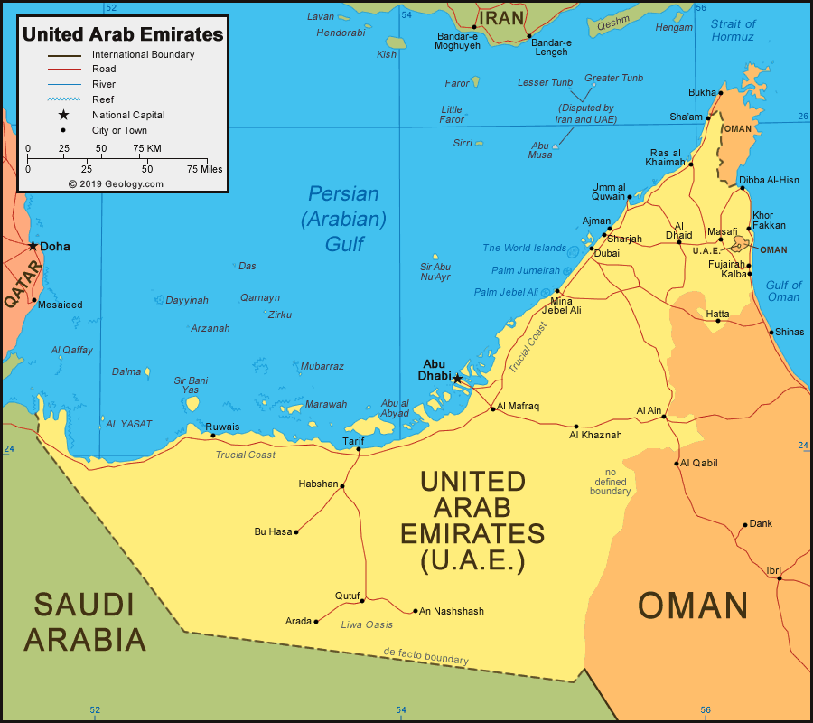
UAE – EMERGING MARKET POTENTIAL
The Situation: A smaller, emerging market.
Growth potential due to traditional dried fruit consumption and growing health awareness among consumers
Action: An ATP investment was won
Primary research was conducted among consumers (qual and quant) and the trade
Ad campaign (trade, OOH) & Gulfood
Results: New trade contacts
INC and additional market support, still to come
Notes:
Should the CPB enter the UAE with a formal marketing campaign

Slide 23
REACTION TO THE TASTE AND THEIR LIKELIHOOD TO BUY PRUNES
How did the consumers react to the concept statement and sample they tried?
“I liked the taste very much. They’re definitely more sweet than sour. I can see using them as an ingredient now – definitely in baking.”
“I find the taste to be more enjoyable than I thought it would be. They’re more sweet than sour and I could see including them more in the things that I eat now – thank you!”
Q. What did you think about the taste of prunes? Based on the concept and what you just ate, how likely would you be to buy prunes?

Slide 24
HOW DOES THE TRADE FEEL
Perceived opportunities for prunes/future of the prune market in the UAE…
“My observations are that interest in prunes is growing and the market for them in the UAE will be expanding – mostly due to health.”
“I’m optimistic about an expanding market for them because we’re getting more information about them and their benefits – both health and snacking/ usage.”
“I believe that as more people learn about the benefits of prunes and how they can be used, they will be buying them more often.”

Slide 25
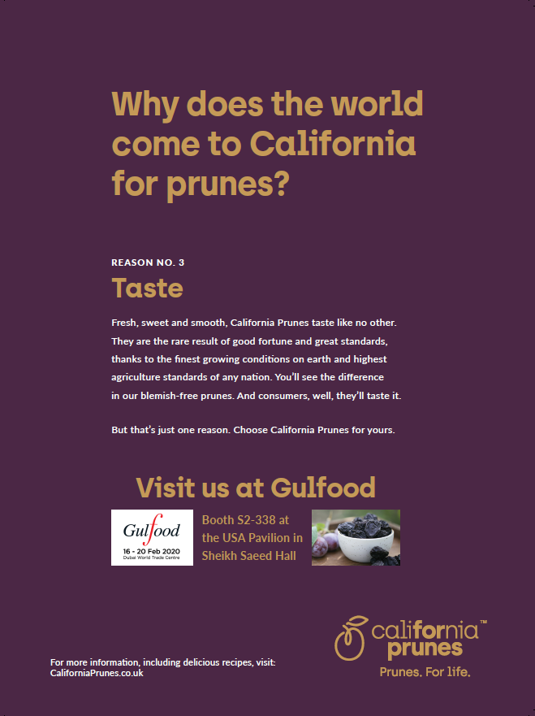
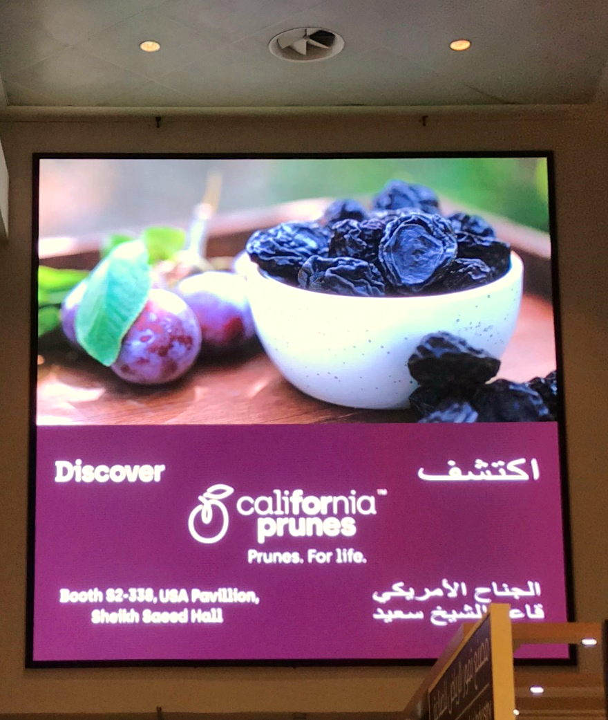
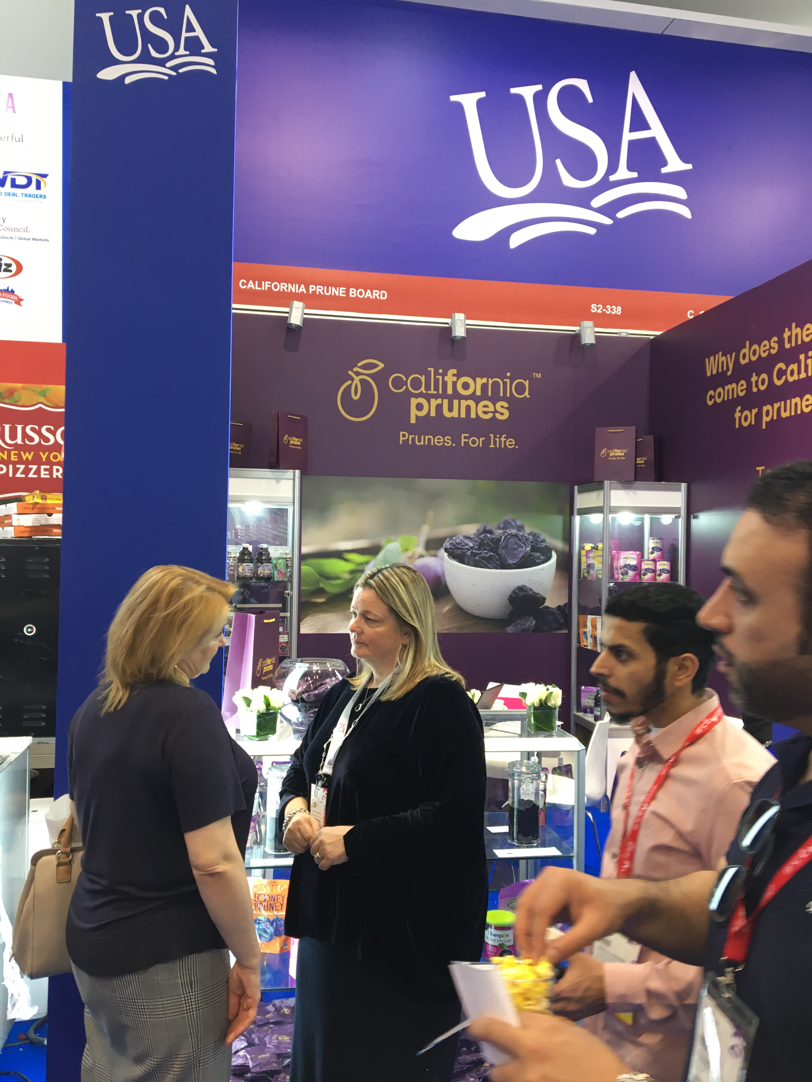
ACTION WE TOOK

Slide 26
CONCLUSIONS
There is not a one-size-fits all communication that will work in every export market.
However, there are some key consistencies seen in terms of the importance of:
Health
Quality
CA origin
Value
And opportunities exist to promote the versatility/usage message, highlight specific health benefits and continue to promote the California origin – all with the goal of “REDEFINING THE VALUE PROPOSITION OF CA PRUNES”!

