Slide 1
California Prunes
FLAVOR CONNECTIONS
Module #1 | The Whole Package

Slide 2
Flavor vs. Taste
Flavor factor is a composite of all the human senses.
TOUCH
SMELL
SOUND
SIGHT
TASTE

Slide 4
It’s a late spring morning in the Sacramento Valley as the sun comes up and the fog settles in for the next few hours – work in the orchards has already begun.

Slide 6
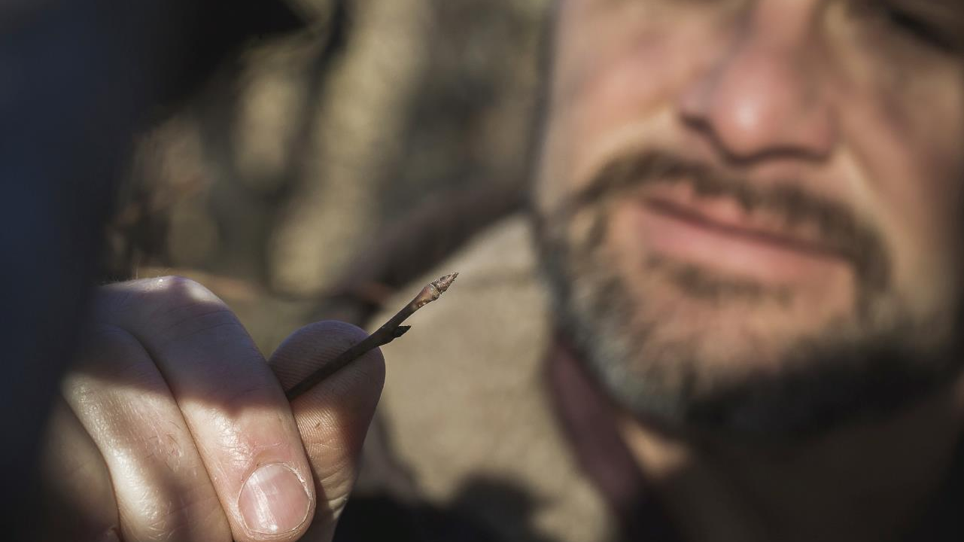

Slide 7
This morning Mike Vasey is inspecting the newly formed buds on prune trees as the chill of morning relents to the sun – bringing another day of growth and life to the orchard.

Slide 8
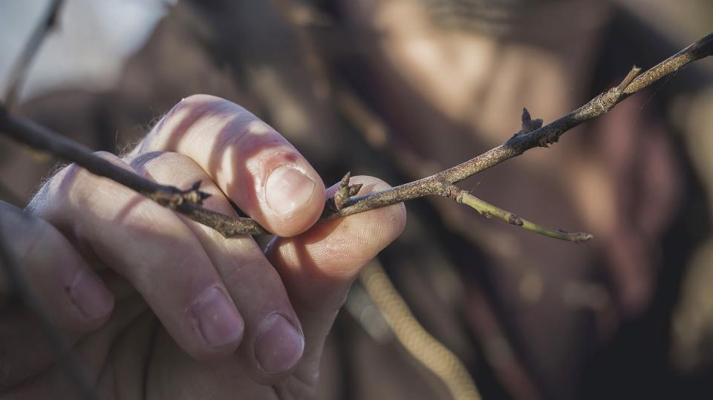

Slide 9
Lindauer River Ranch is home to 50,000 prune trees on 400 acres of land, producing 800 tons of fruit.

Slide 10
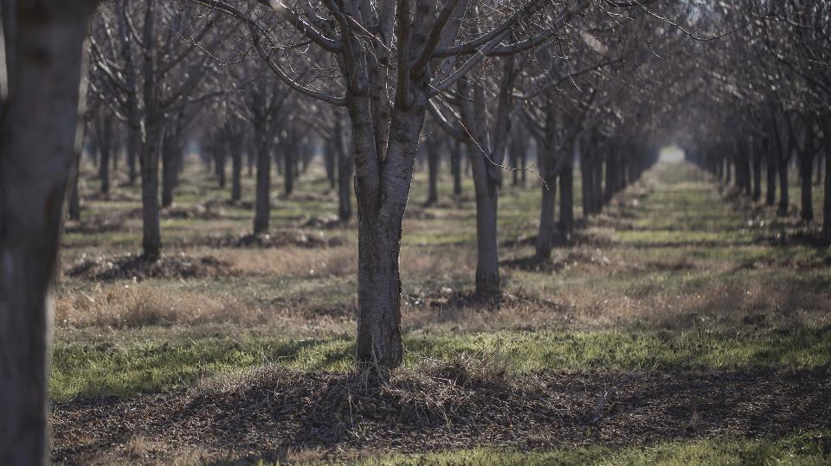

Slide 11
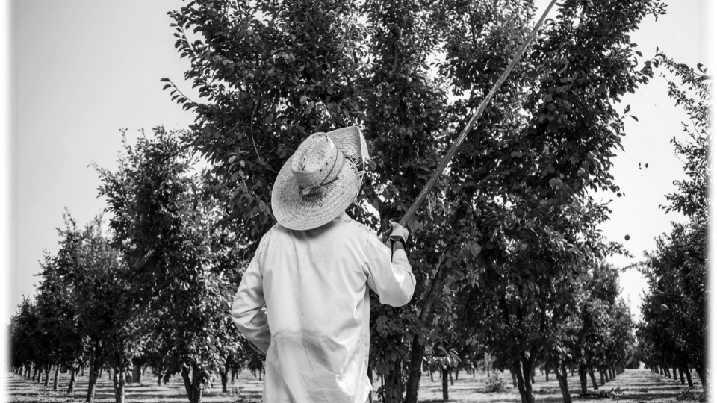

Slide 12
As the weeks go by – orchard hands begin to test the strength of fruit bearing branches. In some cases the fruit will be so heavy that additional support will be needed.

Slide 13
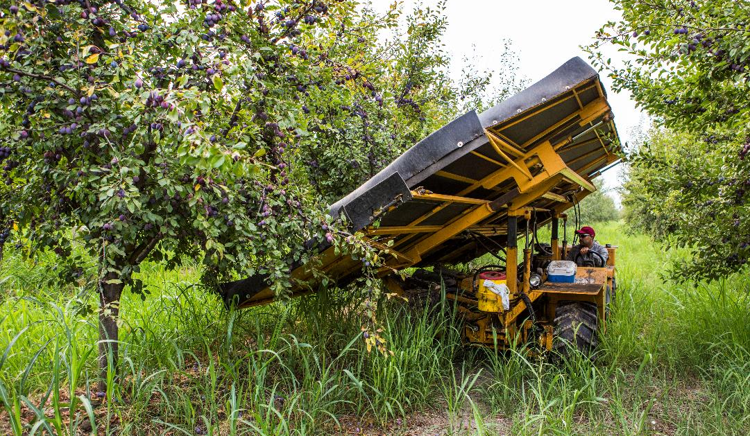
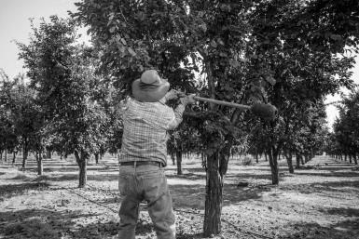

Slide 14
By August the fruit is mature enough to fall from the trees with a bit of encouragement.

Slide 15
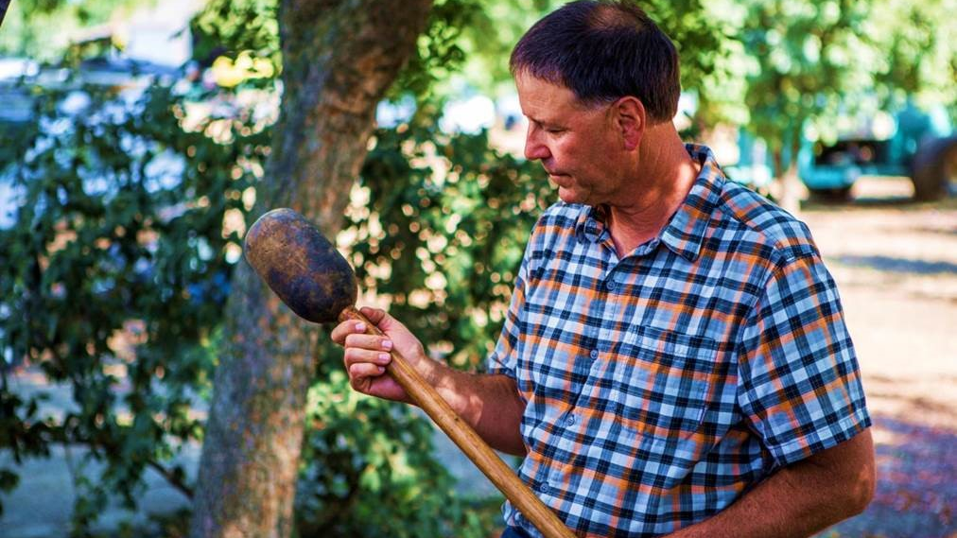

Slide 16
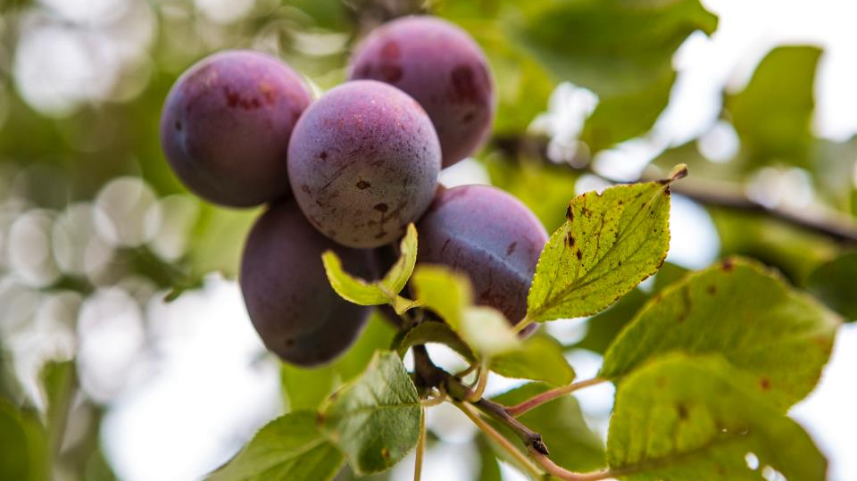

Slide 17
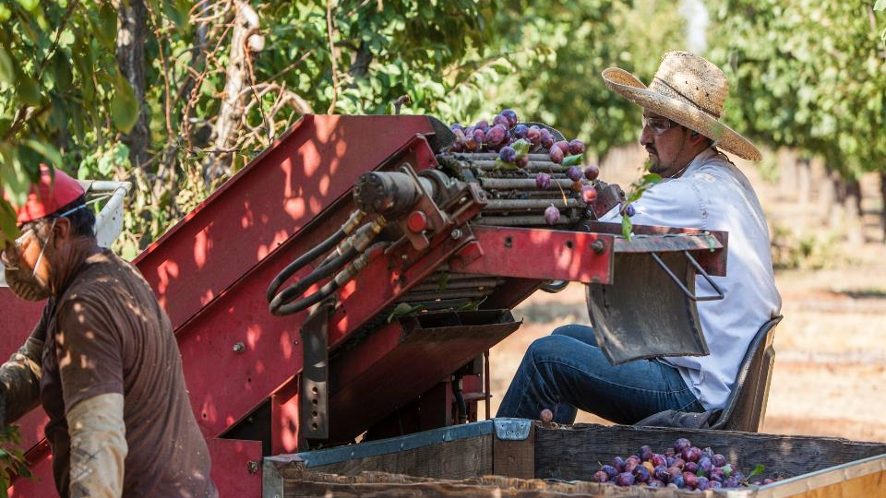

Slide 18
Retrieving the fruit may be mechanized, but the work is still hard and hot. Wide rim hats protect the harvesters from the relentless California sun while the intense smell of ripe fruit permeates the air.

Slide 19
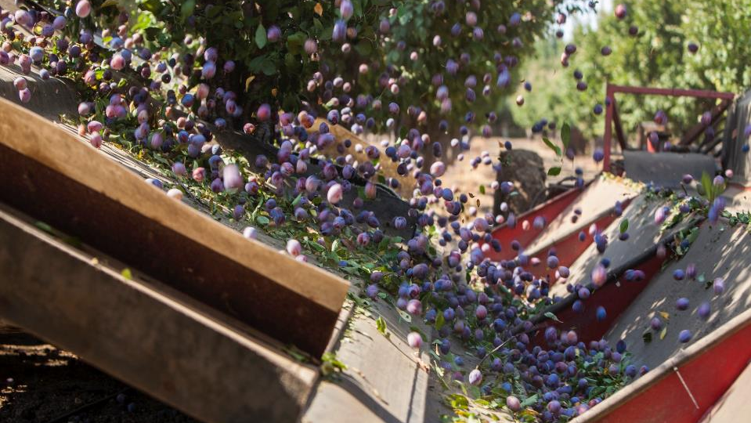

Slide 20
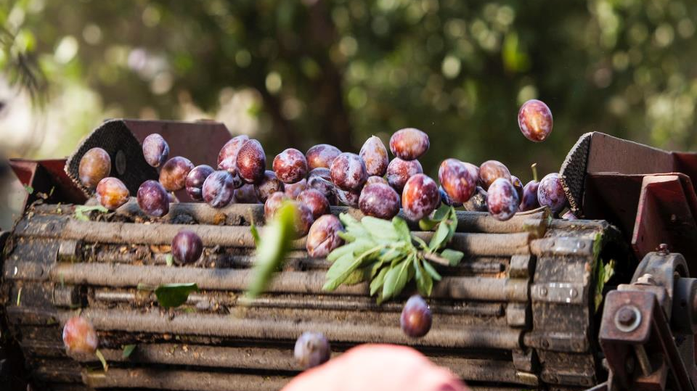

Slide 21
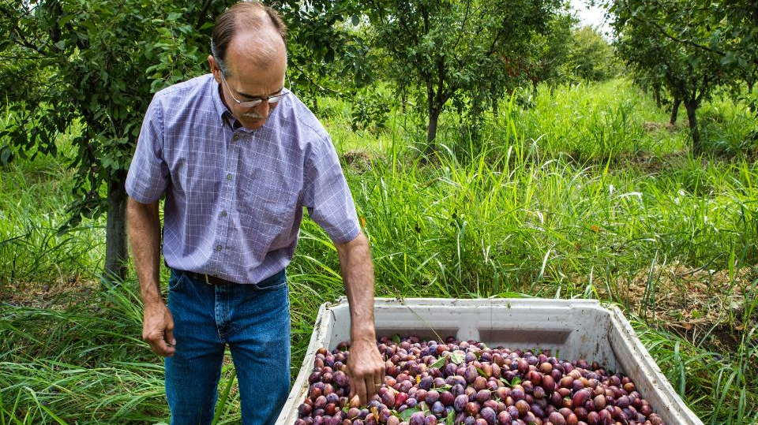

Slide 22
These prunes will be air-dried in dehydrators over a period of 18-24 hours, graded, and stored. When ready to package they are re-hydrated and sterilized before packaging.

Slide 23
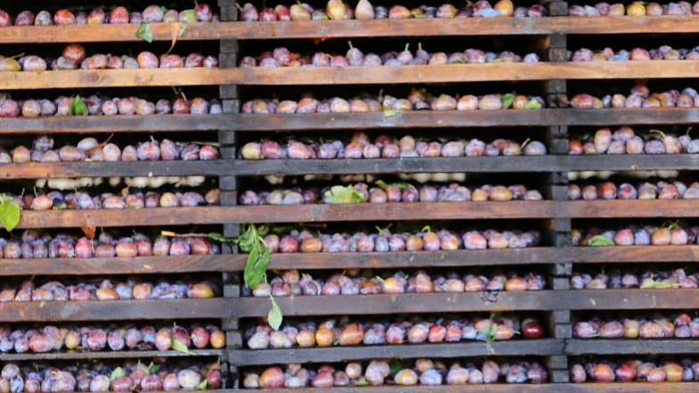

Slide 24
The Process
Prune trees begin bearing fruit – 4-6 years after planting.
By year 8 or so they are producing at capacity.
Trees bear fruit for approximately 30 years.
Fruit is shaken from trees.
It is washed and then placed on trays for commercial dehydration.
3 pounds of fresh prunes will yield 1 pound of dried fruit.

Slide 25
Process Continued
Off to the packaging plant.
Graded for size and inspected for quality.
Stored for packaging when an order is placed.
Rehydrated and sterilized.
Inspected once again and packaged for shipment.

Slide 26
Part of a Healthy Diet
Great for bone health.
Improved digestion.
Great source of antioxidants.
Helps to control blood sugar.
A source of fiber for cholesterol management.

Slide 27
Prunes on Restaurant Menus
California Prunes are a full flavored fruit that provide moisture and texture to menu items, are easily paired with many other ingredient flavors and are an excellent source of nutrition for restaurant guests.

Slide 28
Up Next: Module #2
California Prunes in the Savory Kitchen

